Slide 1
TOOLBOX IN C-SHARP
SUBMITTED BY
ASHWINI KALASKAR

Slide 2
FILESYSTEMWATCHER
FileSystemWatcher listens to the file system and places a watch on a directory, its sub directories, and files and notifies if any changes are made to the directory.
This class is useful when you need to auto update the updates in a directory.
For example, if you want to create an auto backup of a folder, you can implement a File system watcher service that watches a directory or entire machine and find when and what changes are made and copy the changes to the backup device.
FileSystemWatcher acts as a watchdog for file system changes and raises an event when a change occurs. You must specify a directory to be monitored. The class can monitor changes to subdirectories and files within the specified directory.
The option to monitor files with specific extensions can be set using the Filter property of the FileSystemWatcher class. You can also fine-tune FileSystemWatcher to monitor any change in file Attributes, LastAccess, LastWrite, Security, and Size data.

Slide 3
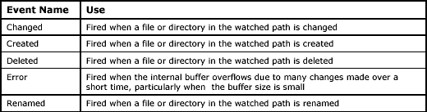
The FileSystemWatcher class raises the events described in Table

Slide 4
STEPS FOR IMPLEMENTING
1. DESIGN-TIME:
Step 1: Create a windows form as shown in the below image: Visual Studio -> File -> New -> Project -> WindowsFormApp.
Step 2: Next, drag and drop the FileSystemWatcher control from the toolbox to the form.
Step 3: After drag and drop you will go to the properties of the FileSystemWatcher to modify FileSystemWatcher according to your requirement.

Slide 5
2. RUN-TIME:
Step 1: Create a FileSystemWatcher using the FileSystemWatcher() constructor is provided by the FileSystemWatcher class.
//Creating a FileSystemWatcher
FileSystemWatcher fl = new FileSystemWatcher ();
Step 2: After creating a FileSystemWatcher, set the property of the FileSystemWatcher provided by the FileSystemWatcher class.
//Path of the folder where the changes will be stored
watcher.Path = @"E:/images/";
//watch any type of files
watcher.Filter = "*.*";

Slide 6
/* Watch for changes in LastAccess and LastWrite times, and
the renaming of files or directories. */
watcher.NotifyFilter = NotifyFilters.LastAccess | NotifyFilters.LastWrite
| NotifyFilters.FileName | NotifyFilters.DirectoryName;
// Add event handler.
watcher.Changed += new FileSystemEventHandler(OnChanged);
// Begin watching.
watcher.EnableRaisingEvents = true;

Slide 7
CODE:
using System;
using System.IO;
using System.Windows.Forms;
namespace FruitCatalog
{
public partial class Filesystemwatcherex : Form
{
FileSystemWatcher watcher;
public Filesystemwatcherex()
{
InitializeComponent();
}
private void Filesystemwatcher_Load(object sender, EventArgs e){
watch();
}
void watch()
{
try
{
// Create a new FileSystemWatcher and set its properties.
watcher = new FileSystemWatcher();
watcher.Path = @"E:/images/";
//watch any type of files
watcher.Filter = "*.*";

Slide 8
/* Watch for changes in LastAccess and LastWrite times, and
the renaming of files or directories. */
watcher.NotifyFilter = NotifyFilters.LastAccess | NotifyFilters.LastWrite
| NotifyFilters.FileName | NotifyFilters.DirectoryName;
// Add event handler.
watcher.Changed += new FileSystemEventHandler(OnChanged);
// Begin watching.
watcher.EnableRaisingEvents = true;
}
catch (Exception)
{
MessageBox.Show("Not found");
}
}
// Define the event handler.
private void OnChanged(object source, FileSystemEventArgs e)
{
//Copies file to another directory or another action.
MessageBox.Show("File : " + e.FullPath + " " + e.ChangeType);
}
}
}

Slide 9
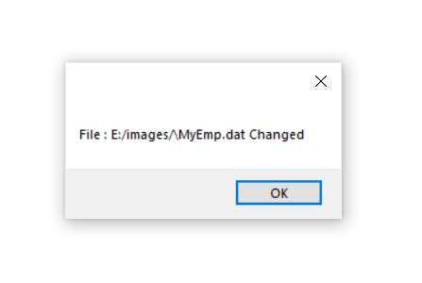
OUTPUT FOR FILESYSTEMWATCHER

Slide 10
FLOWLAYOUTPANEL
The FlowLayoutPanel control is a container control that provides dynamic layout for the child controls that can be arranged horizontally or vertically. The flow direction of the control sets the direction of arrangements of controls.
We can create a FlowLayoutPanel control using the Forms designer at design-time or using the FlowLayoutPanel class in code at run-time (also known as dynamically).

Slide 11
STEPS FOR IMPLEMENTING
1. DESIGN-TIME:
Step 1: Create a windows form as shown in the below image: Visual Studio -> File -> New -> Project -> WindowsFormApp.
Step 2: Next, drag and drop the FlowLayoutPanel control from the toolbox to the form.
Step 3: After drag and drop you will go to the properties of the FlowLayoutPanel to modify FlowLayoutPanel according to your requirement.

Slide 12
2. RUN-TIME:
Step 1: Create a FlowLayoutPanel using the FlowLayoutPanel() constructor is provided by the FlowLayoutPanel class.
//Creating a FlowLayoutPanel
FlowLayoutPanel fl = new FlowLayoutPanel();
Step 2: After creating a FlowLayoutPanel, set the property of the FlowLayoutPanel provided by the FlowLayoutPanel class.
// Setting the location of the FlowLayoutPanel
fl.Location = new Point(380, 124);
// Setting the size of the FlowLayoutPanel
fl.Size = new Size(216, 57);
// Setting the name of the FlowLayoutPanel
fl.Name = "Mycontainer";
// Setting the font of the FlowLayoutPanel
fl.Font = new Font("Calibri", 12);

Slide 13
// Setting the flow direction of the FlowLayoutPanel
fl.FlowDirection = FlowDirection.RightToLeft;
// Setting the border style of the FlowLayoutPanel
fl.BorderStyle = BorderStyle.Fixed3D;
// Setting the foreground color of the FlowLayoutPanel
fl.ForeColor = Color.BlueViolet;
// Setting the visibility of the FlowLayoutPanel
fl.Visible = true;
Step 3: And last add this FlowLayoutPanel control to the form and also add other controls on the FlowLayoutPanel using the following statements:
// Adding a FlowLayoutPanel control to the form
this.Controls.Add(fl);
// Adding child controls to the FlowLayoutPanel
fl.Controls.Add(f1);

Slide 14
CODE:
using System;
using System.Drawing;
using System.Windows.Forms;
namespace FruitCatalog
{
public partial class Flowlayoutpanelex : Form{
public Flowlayoutpanelex(){
InitializeComponent();
}
private void Flowlayoutpanel_Load(object sender, EventArgs e)
{
// Creating and setting the properties of FlowLayoutPanel
FlowLayoutPanel fl = new FlowLayoutPanel();
fl.Location = new Point(180, 125);
fl.Size = new Size(250, 60);
fl.Name = "Myflowpanel";
fl.Font = new Font("Calibri", 12);
fl.FlowDirection = FlowDirection.RightToLeft;
fl.BorderStyle = BorderStyle.Fixed3D;
fl.ForeColor = Color.BlueViolet;
fl.Visible = true;
// Adding this control to the form
this.Controls.Add(fl);

Slide 15
// Creating and setting the properties of radio buttons
RadioButton f1 = new RadioButton();
f1.Location = new Point(3, 3);
f1.Size = new Size(95, 20);
f1.Text = "R1";
// Adding this control to the FlowLayoutPanel
fl.Controls.Add(f1);
RadioButton f2 = new RadioButton();
f2.Location = new Point(94, 3);
f2.Size = new Size(95, 20);
f2.Text = "R2";
fl.Controls.Add(f2);
RadioButton f3 = new RadioButton();
f3.Location = new Point(3, 26);
f3.Size = new Size(95, 20);
f3.Text = "R3";
fl.Controls.Add(f3);
}
}
}

Slide 16
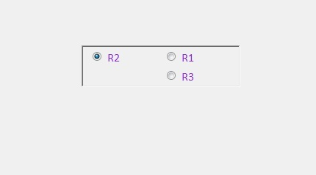
OUTPUT FOR FLOWLAYOUTPANEL

Slide 17
THANK YOU!

